Slide 1

BLOOD PRESSURE ANALYSIS
Aiders
Sanjay A
Lokesh Babu A
Sharukeshan R
Mohamed Sigan K

Slide 2

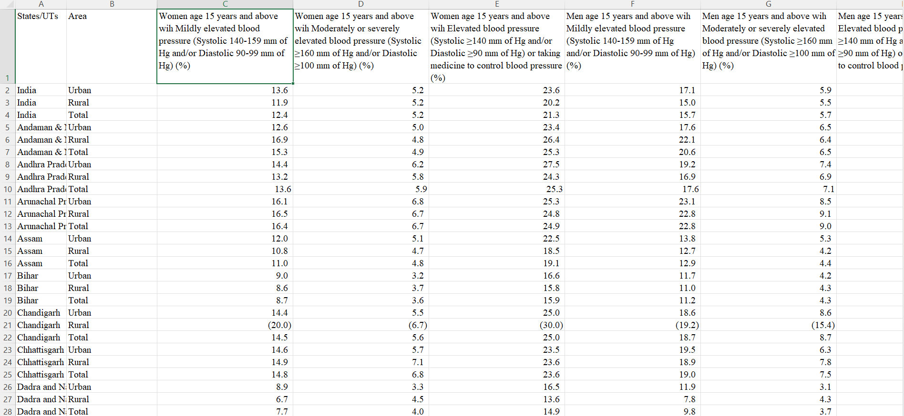
Source:
https://www.kaggle.com/datasets/nitishsinghal/blood-pressure-data-india-2021-statewise

Slide 3
Normal Blood Pressure:
Elevated blood pressure: Your systolic pressure is 120-129, and your diastolic pressure is less than 80. Stage I hypertension: Systolic 130-139 or diastolic 80-89.
Mildly Elevated Blood Pressure:
Mildly elevated blood pressure (Systolic 140-159 mm of Hg and/or Diastolic 90-99 mm of Hg)
Severely Elevated Blood Pressure:
Moderately or severely elevated blood pressure (Systolic ≥160 mm of Hg and/or Diastolic ≥100 mm of Hg)
Elevated Blood Pressure:
Elevated blood pressure (Systolic ≥140 mm of Hg and/or Diastolic ≥90 mm of Hg) or taking medicine to control blood pressure

Slide 4
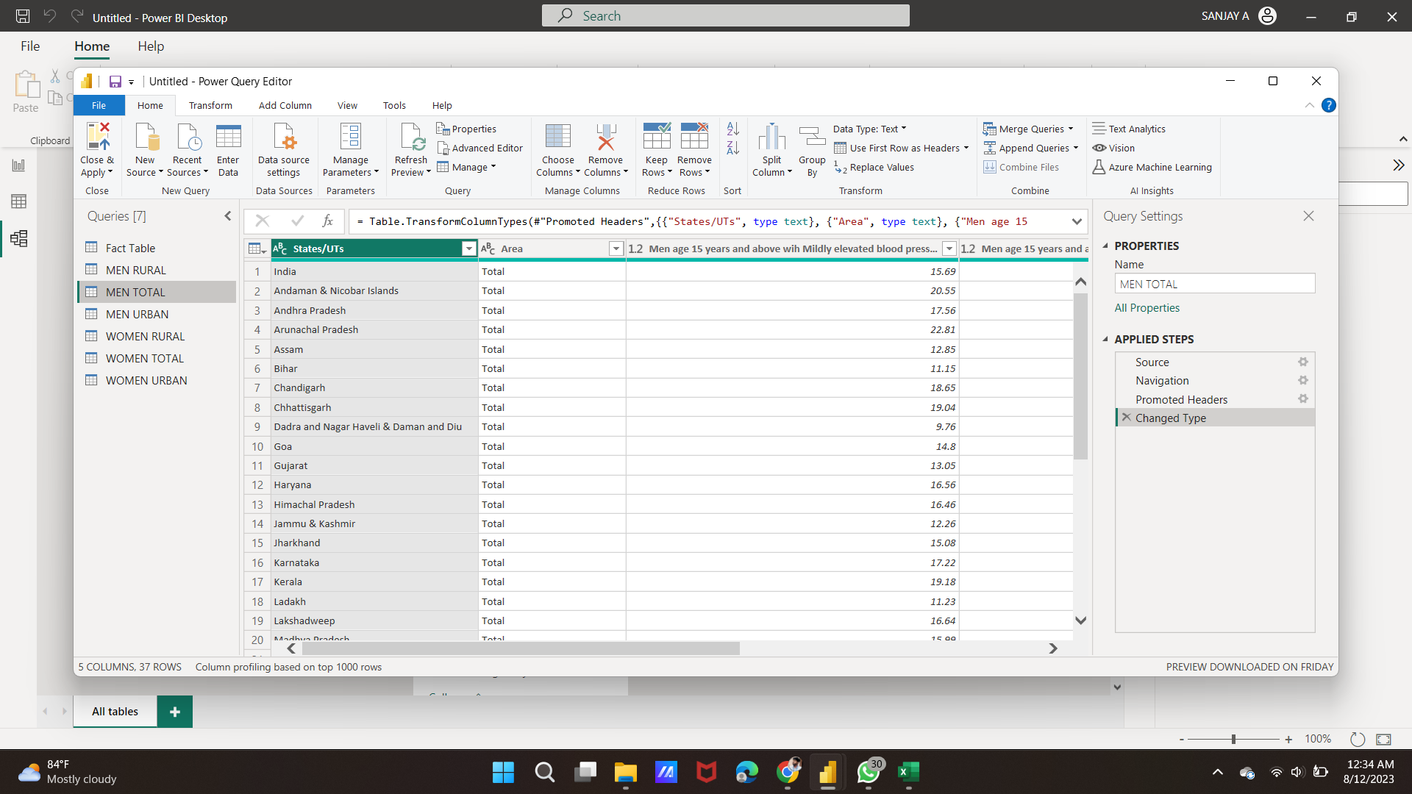

Slide 5
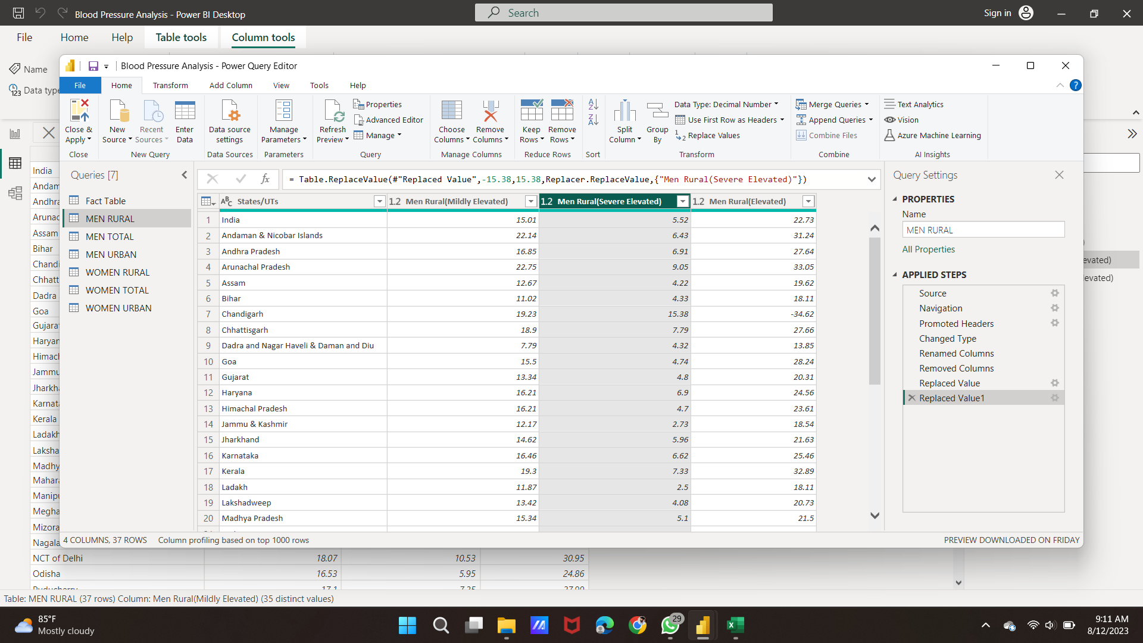

Slide 6
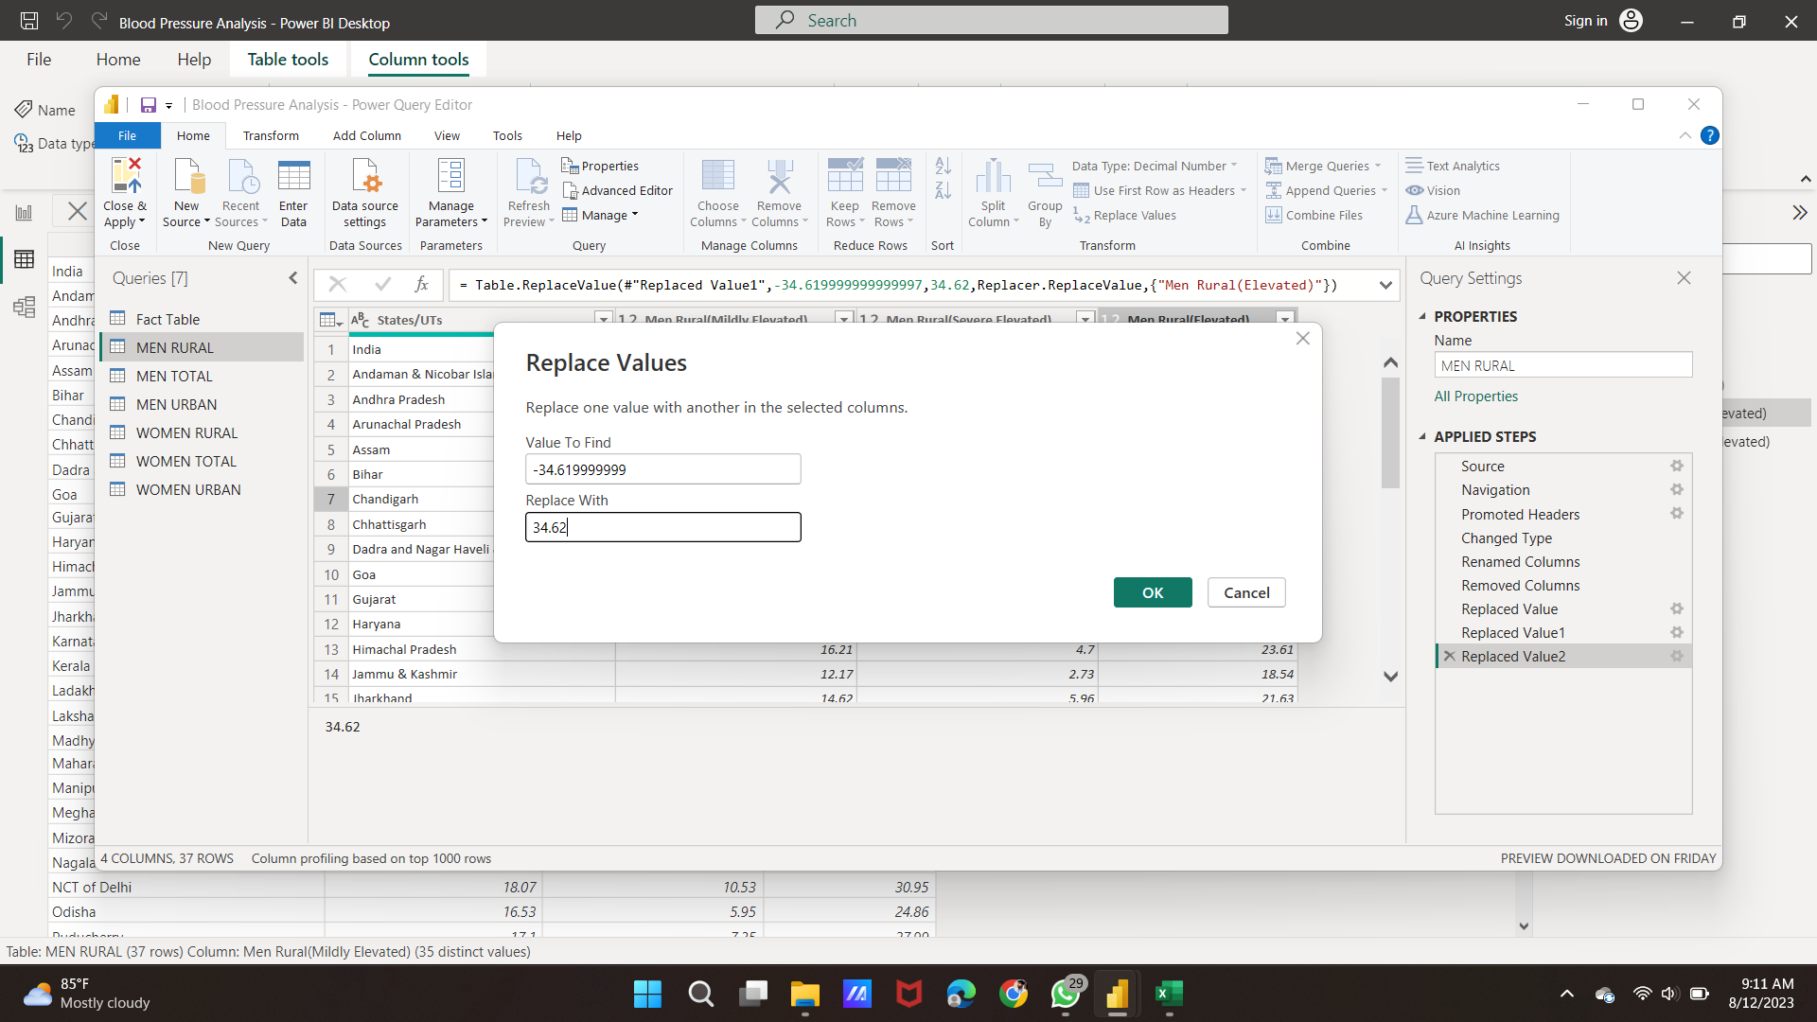

Slide 7
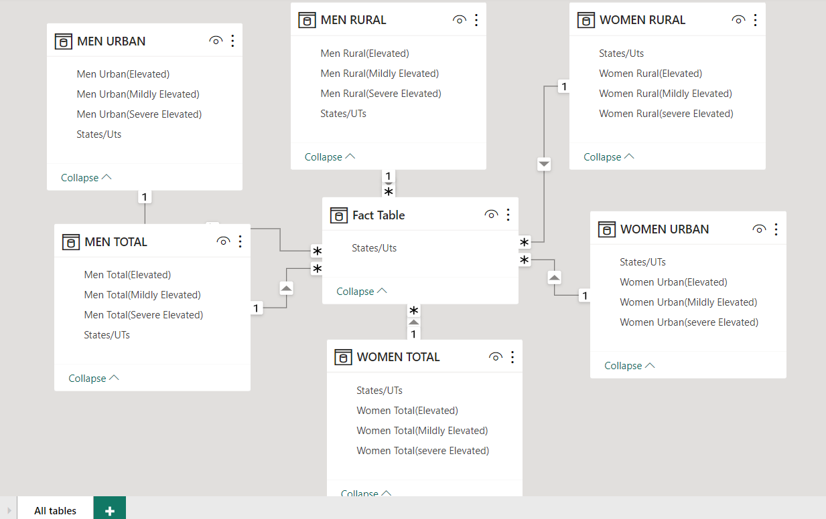
STAR SCHEMA

Slide 8
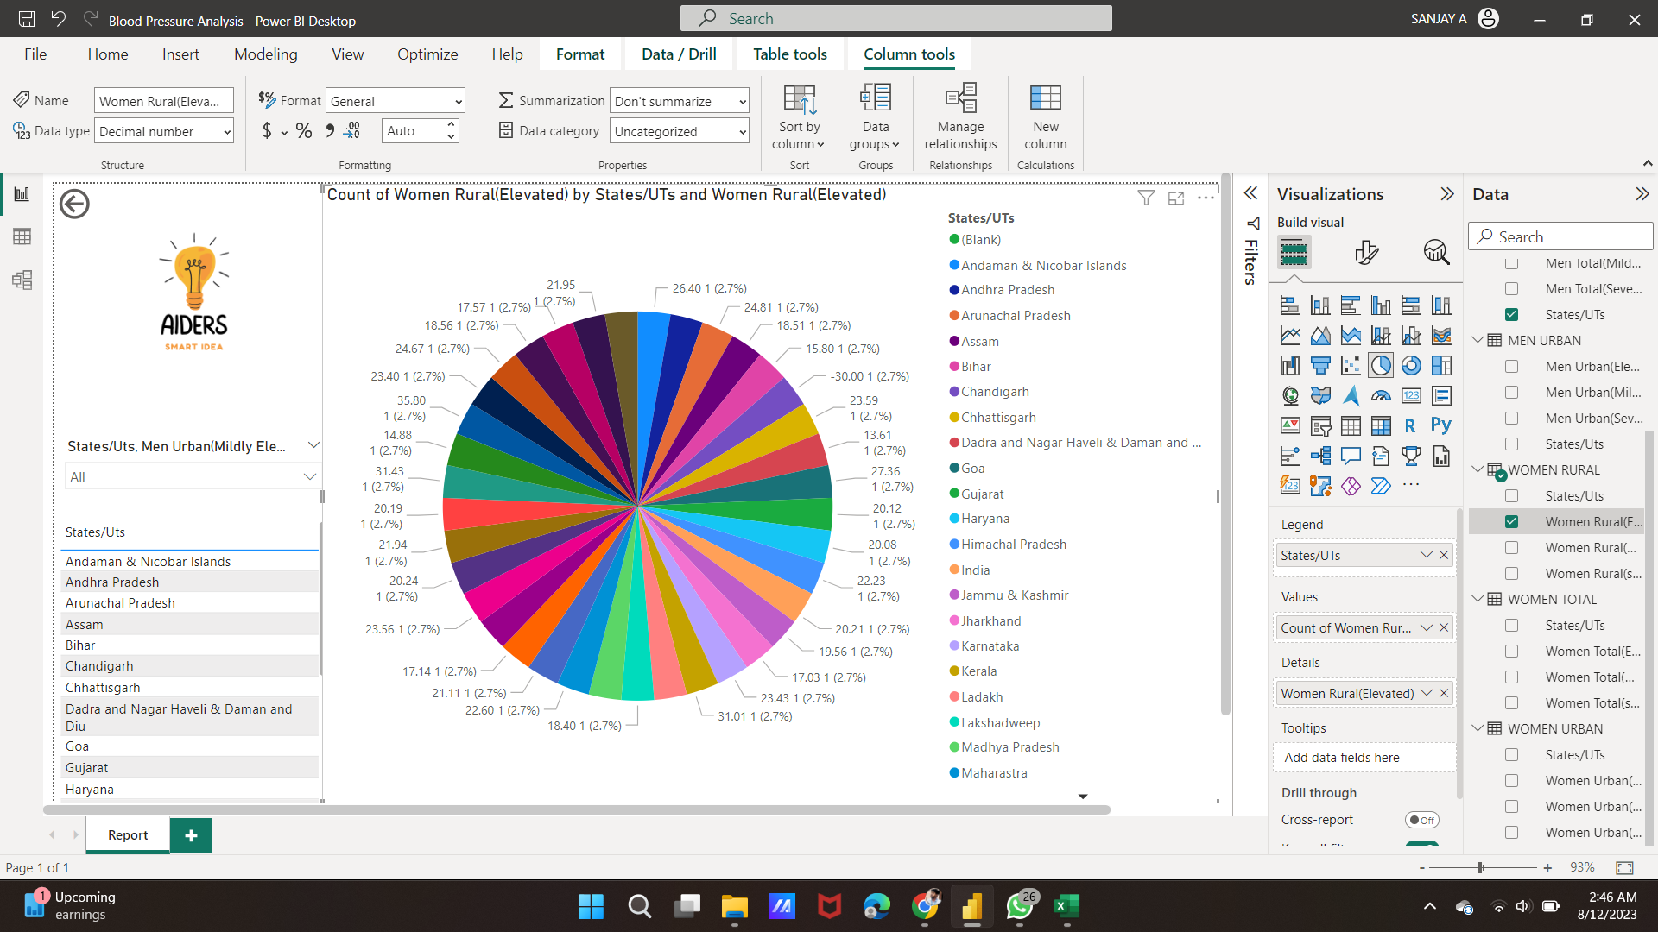
INITIAL VISUAL USING PIE CHART

Slide 9
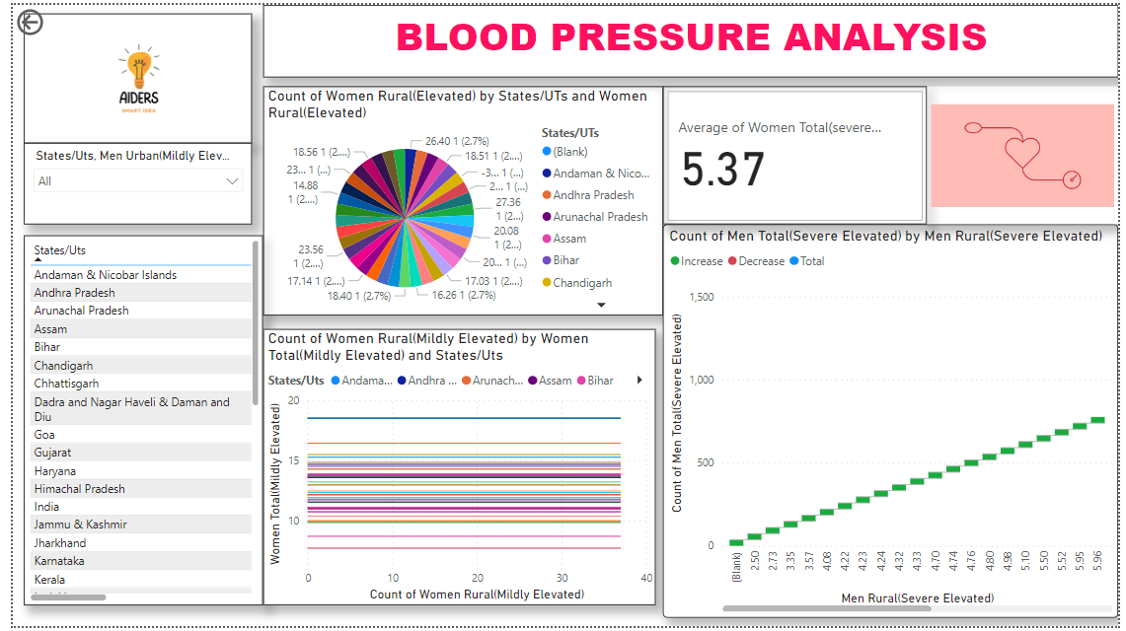
PAGINATED REPORT

Slide 10

THANK YOU

